Slide 1
What killed Nashville?
A Look at the City’s Most Common Causes of Death in the 19th Century

Slide 2
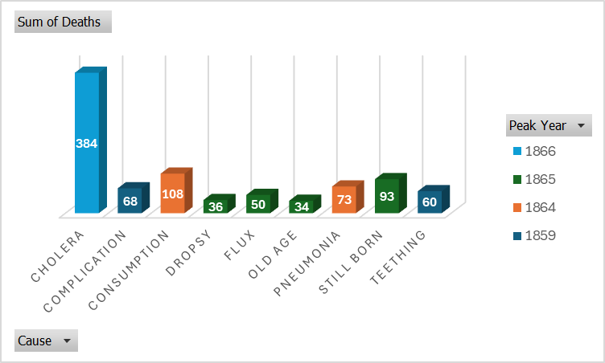
Top Causes of Death by Peak Year in Nashville
What the Data Reveals:
. The most deadly years were often clustered around epidemics or crisis periods. Cholera in 1866 stands out with 384 deaths — by far the highest peak for a single cause. Other top causes like Consumption and Complication reflect the limitations of 19th-century medicine, where diseases we now treat easily were often fatal.
1865: A Year of Multiple Crises
Many causes -including Still Born, Flux, Dropsy, and Old Age — peaked in 1865. While Cholera’s peak followed in 1866, and Consumption and Pneumonia both peaked in 1864, burial records show all three years had similarly high death tolls.
In fact, 1864, 1865, and 1866 each had over 1,350 recorded burials, with 1864 being the highest at 1,372. This clustering of high mortality strongly suggests that the final stages and immediate aftermath of the Civil War created conditions that worsened public health
Data source: Historic Nashville City Cemetery Interments

Slide 3
Misunderstood Causes and Civil War Impact
What Was Cholera?
Cholera is a deadly waterborne disease that causes severe diarrhea and dehydration. In the 1800s, it spread rapidly through contaminated water sources, especially in densely populated areas with poor sanitation. The outbreak in 1866 devastated Nashville, contributing to the highest death toll from a single cause in the dataset.
Teething as a Cause of Death:
In the 19th century, "teething" was often cited as a cause of death for infants. Without medical understanding of infection or fever-related complications, families and doctors attributed unexplained infant deaths to this natural stage. Across the full dataset, teething caused 595 deaths in Nashville—making it one of the most frequently cited causes. In 1854 alone, it accounted for 60 deaths.
Civil War Spike in Burials:
Burial records show a sharp increase in deaths during the Civil War years:
1864: 1,372 total burials
1865: 1,366 total burials — the second highest year on record
1866: 1,354 total burials (includes 384 cholera deaths)

Slide 4
Yes, People Really Died from These
Causes That May Surprise You
Teething —Misunderstood fever, infection, or convulsions in infants were often blamed on teething.
Consumption — The historical name for tuberculosis. A slow, wasting lung disease, it was one of the deadliest infections before antibiotics.
Dropsy —An old term for fluid retention (now called edema), usually linked to heart failure or kidney disease.

Slide 5
Final Reflections
Many of the causes we see in this dataset like teething or dropsy show how much we take modern medicine for granted. Diseases that are easily treated today were often fatal in the 1800s. Looking back helps us understand just how far medical knowledge and public health have come.
Emelly Valdez | Nashville Software School | May 2025

